Slide 1
National Standards
for Health and Social Care Services
- An Introduction

Slide 2
Introduction
What is the purpose of this slide deck?
This slide deck has been developed by the Health Information and Quality Authority (HIQA) to provide a teaching resource on the development of evidence-based national standards for health and social care services in Ireland.
Who is this slide deck for?
This slide deck will be useful for those teaching health and social care students and those providing training for health and social care staff.
Managers of health and social care services, policy-makers, and others who have a personal or professional interest in national standards may also find this slide deck useful.

Slide 3
Introduction
How can this slide deck be used?
The slide deck has been designed to be used in a flexible way.
Content has been divided into different sections and these can be delivered together, or separately as individual modules.
These slides may be adapted for teaching and training purposes.
We ask that you acknowledge HIQA as the source of these materials.
Fore the most recent version of this slide deck, visit our Learning Hub.

Slide 4
Content of the slide deck
Section 1: About the Health Information and Quality Authority (HIQA)
Section 2: About National Standards for Health and Social Care Services
Section 3: How National Standards are used by HIQA and the Chief Inspector of Social Services
Section 4: Implementation Support Tools (guidance)
Section 5: Impact

Slide 5
Section 1. About the Health Information and Quality Authority (HIQA)
Notes:
This section provides a brief outline of the role of the Health Information and Quality Authority (HIQA) and the function of HIQA’s Standards Development Team.

Slide 6
The Health Information and Quality Authority (HIQA)
HIQA is an independent statutory authority, established in 2007, to improve the safety and quality of health and social care services for the public.
HIQA’s Mission “Protecting service users, and working with stakeholders to enhance and enable equity, quality and safety of health and social care services for all people in Ireland”.
HIQA’s Values
Promoting and protecting human rights
Putting people first
Being fair, objective and equitable
Being open and accountable
Striving for excellence
Promoting quality
Working collaboratively

Slide 7
HIQA’s Functions
Standards & Quality
Developing person-centred standards and tools (guidance) for health and social care services.
Regulation
Regulating residential services for older people, people with a disability and children’s special care units, as well as medical exposure to ionising radiation (for example, X-rays).
Monitoring
Monitoring the quality and safety of health services and children’s social services.
Notes:
Setting standards for health and social care services
Developing person-centred standards and implementation support tools (guidance), based on evidence and international best practice, for health and social care services in Ireland.
Regulating social care services
The Chief Inspector within HIQA is responsible for registering and inspecting residential services for older people and people with a disability, and children’s special care units.
Regulating health services
Regulating medical exposure to ionising radiation.
Monitoring services
Monitoring the safety and quality of health services and children’s social services, and investigating, as necessary, serious concerns about the health and welfare of people who use these services.

Slide 8
HIQA’s Functions
Health Technology Assessment
Evaluating the clinical and cost-effectiveness of health programmes, policies, medicines, medical equipment, diagnostic and surgical techniques, and health promotion and protection activities.
Health Information
Developing a consistent and standardised approach to health and social care information, including in National Data Collections and eHealth services in Ireland.
National Care Experience Programme
Carrying out service-user experience surveys, including the National Inpatient Experience Survey, National Maternity Experience Survey and Nursing Home experience survey.
Notes:
Health Technology Assessment
Evaluating the clinical and cost-effectiveness of health programmes, policies, medicines, medical equipment, diagnostic and surgical techniques, health promotion and protection activities, and providing advice to enable the best use of resources and the best outcomes for people who use our health service.
Health Information
Advising on the efficient and secure collection and sharing of health information, setting standards, evaluating information resources and publishing information on the delivery and performance of Ireland’s health and social care services.
National Care Experience Programme
Carrying out national service-user experience surveys across a range of health services, in conjunction with the Department of Health and the Health Service Executive (HSE).

Slide 9
Health Information and Standards
The Health Information and Standards Directorate aims to support a consistent and standardised approach to health and social care service provision and information in Ireland and bring about effective and sustainable improvements to Irish health and social care services. It has three core functions:
Development of National Health and Social Care Standards
The Standards Team develops national standards and implementation support tools for health and social care services.
Informing and driving health information quality and eHealth
The Technical Standards Team and the Health Information Quality Team develop recommendations, national standards and guidance for the Irish eHealth and health information landscape, and assess against national standards.
Surveying the experiences of people who use health and social care services
The National Care Experience Programme asks people about their experiences of care in order to improve the quality of health and social care services in Ireland.
Notes:
Further information about the National Care Experience Programme is available on the National Care Experience website: www.yourexperience.ie

Slide 10
Section 2. About National Standards for Health and Social Care Services

Slide 11
What are National Standards
National standards are a set of high-level outcomes that describe how services can achieve safe, quality, person-centred care and support. They are evidence-based and informed by engaging with those who use and provide our health and social care services.
National Standards:
provide a common language to describe what high-quality, safe, person-centred care looks like.
create a basis for services to improve the quality and safety of the care they deliver, by identifying strengths and highlighting areas for improvement.
assist people using services to understand what they should expect from a service.
promote practice that is up to date, effective and consistent.
Notes:
It is recognised internationally that the setting and implementation of quality standards are important drivers to improve health and social care.
They are also a resource for people using services to understand what safe, high-quality care looks like and what to expect from a service.
Standards, on their own, do not improve quality and safety. There are interdependencies with legislation, national policy, local structures, supports and policies. Buy-in from services and staff that this is the right thing to do is also needed, in order for the standards to be implemented in practice.
HIQA supports the implementation of national standards by developing guidance/tools and other resources, such as online learning courses, to support staff to understand how the standards relate to their own everyday work and to help services to make improvements in particular areas.

Slide 12
Legislative Basis for National Standards
Under the Health Act, 2007
Section 8(1)(b):
Set Standards on the safety and quality of services provided by the HSE, Tusla or service providers under Health Acts, Children Act and Childcare Act 1991 and advise the Ministers, HSE and Tusla in relation to the particular service in respect of which standards are set.
Section 7:
Promote safety and quality in the provision of health and social services for the benefit of the health and welfare of the public.
Notes:
Under the Health Act 2007, one of HIQA’s functions is to set standards, based on evidence, to drive improvement in health and social care services.
The national standards developed by HIQA aim to help drive improvements in the quality and safety of health and social care services.
Section 7 of the Health Act 2007 outlines HIQA’s role in promoting safety and quality in the provision of health and social services for the benefit of the health and welfare of the public.
Working in conjunction with a wide range of stakeholders, HIQA aims to improve the quality and safety of health and social care services, by setting national standards and developing implementation support tools.

Slide 13
National Standards
There is currently a total of 11 national standards developed by HIQA for health and social care services and 1 set of information management standards for national health and social care data collections.
Overarching standards
Social care standards
Healthcare standards
Information management standards
Notes:
HIQA has developed national standards for a range of health and social care services, including older persons, disability services, acute healthcare settings and residential settings, from the national standards for safer better healthcare in 2012 to the national standards for adult safeguarding in 2019.
HIQA has also published specific standards for the management of health information — Information management standards for national health and social care data collections. The purpose of these standards is to improve the quality of health information across Ireland’s national data collections. National data collections (NDCs) are national repositories of routinely collected health and social care data in Ireland. NDCs play a vital role by providing a national overview of a particular health or social care-related issue or service. Some examples include: The Hospital In-Patient Enquiry (HIPE) managed by the National Screening Service, the National Incident Management System (NIMS) jointly-managed by the HSE and State Claims Agency and the National Childcare Information System (NCCIS) managed by Tusla.
The standards provide a framework of best practice in the collection of health and social care data and cover key areas of information management such as governance, leadership and management, information governance and use of information. The information management standards complement the National Standards for Safer Better Healthcare and together these standards provide a roadmap to improve the quality of health information and data.
The collection, use and sharing of health information is critical to delivering direct care to individuals using health and social care services. It is vital that data be of high quality and used to its maximum potential. The most recent Catalogue of National Data Collections was published by HIQA in October 2022.

Slide 14
How National Standards are Developed
Scoping review and consultation
Evidence review
Public consultation
Advisory Group and Focus Groups
National standards
Total timeframe approx. 18-24 months
HIQA follows a Standards Development Process to ensure national standards are:
fit-for-purpose
evidence based
can be implemented in practice
will ultimately improve the experience of people using services.
Notes:
The Standards Team at HIQA uses an established process to develop national standards for health and social care. This process was developed following a review of national and international evidence, engagement with national and international experts and applying HIQA’s knowledge and experience of the health and social care context.
The standards development process involves the following stages:
Scoping review and consultation
At this stage an Advisory Group is set-up and a targeted public scoping consultation is held to assist HIQA during each stage of developing the national standards. Additionally, a scoping review is conducted to inform the systematic review of literature.
2) Evidence Review
The Standards team undertakes a detailed review of published research, legislation, strategies, guidance, existing programmes, academic literature and any other documents that are relevant to the topic.
3) Advisory Group and Focus Groups
The Standards team engages with relevant stakeholders through focus groups. The findings from the focus groups are presented to the Advisory Group, written up in the Stakeholder involvement report and used to inform the draft standards.
4) Public Consultation
Public consultation is an integral part of the Standards development process. When developing standards, HIQA holds two public consultations.
The first public consultation is held at the start of the development process to consult with relevant stakeholders on the areas the Standards will cover. The second public consultation is held once the draft Standards are developed.
5 National Standards and Guidance
Once approval is received, the National Standards are launched and published on the HIQA website, along with any related documents.

Slide 15
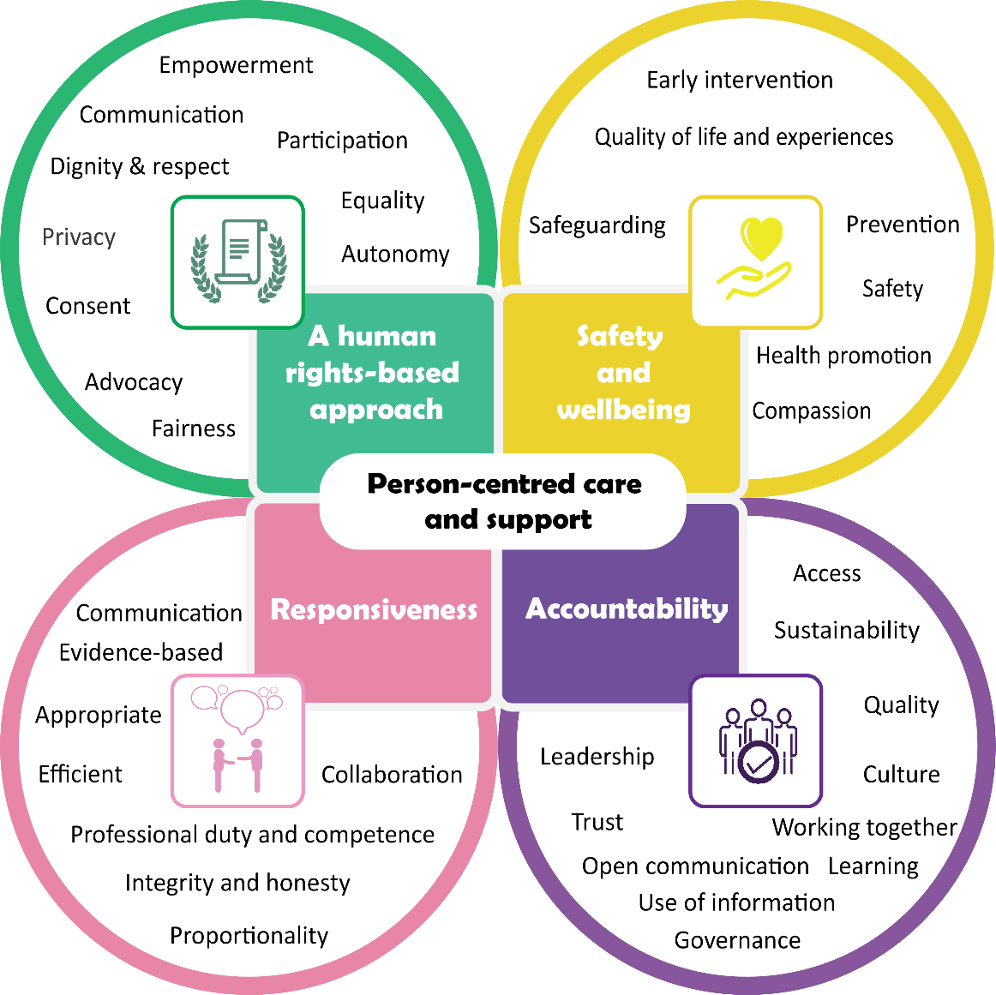
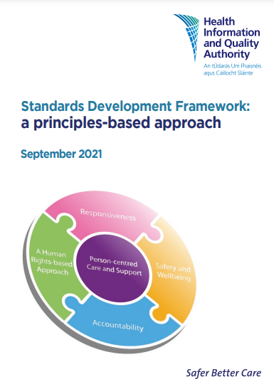
Standards Development Framework:
A Principles-based Approach
Available online from:
https://www.hiqa.ie/sites/default/files/2021-09/Standards-Development-Framework-a-principles-based-approach.pdf
Notes:
In line with emerging international evidence, HIQA developed a set of principles to underpin all national standards for health and social care services.
In September 2021 the standards team published a new standards development framework – a principles-based approach.
The principles have been developed to be used consistently across all national standards developed by HIQA, irrespective of the setting or service type.
The principles underpin all national standards, including any tools developed to support their implementation.
This image sets out the four evidence-based principles and includes examples of the components of each principle. Importantly, it also illustrates that the person receiving care and support should be at the core of everything with each of the principles working together to achieve person-centred care and support.
These principles were developed based on engagement with stakeholders, international evidence, as well as evidence from review of academic and grey literature. The evidence review informing this work is available on the HIQA website.
It is important to note that this does not affect existing national standards, which will remain in place until such time as a decision is made, in line with HIQA’s prioritisation process, to review and update them. Any such decision to review or update existing standards will be informed by consultation with stakeholders.

Slide 16
Principle 1:
A human rights-based approach
How a person experiences a human rights-based approach:
My rights are protected and promoted by health and social care services and are explained to me in a way that I can understand. I am treated with dignity and respect and I do not experience discrimination for any reason when I am accessing or using services. I am valued and recognised as an individual who is able to participate in and exercise control over my life. I have a right to participate in decisions about my care and support, and when appropriate my family and the people caring for me are included in this process. Services work to support my participation. This ensures that I, and the important people in my life, can express our views, feelings and wishes in order to effect change in the care and support that I receive.
Notes:
The principle of a human rights-based approach (HRBA) means that health and social care services respect, protect and promote the human rights of the person receiving care and support at all times.
Human rights are the basic rights and freedoms that all people should enjoy and everyone is entitled to have their human rights respected and protected.
These rights, in a health and social care context, include the right to autonomy and to make informed choices, to be treated with dignity and respect and in an equal† and non-discriminatory manner, the right to privacy and the right to safety.
Health and social care services take a HRBA to care and support by treating people fairly, with respect, equality and dignity, recognising and valuing people as individuals and supporting them to participate as fully as possible in decisions about their care and support and exercise control over their lives according to personal values, beliefs and preferences.
When necessary, service providers ensure that the individual is supported to make decisions in line with relevant national legislation, such as the Assisted Decision Making (Capacity) Act 2015, and national policies and guidelines are utilised to support informed consent and assisted decision making.

Slide 17
Principle 2:
Safety and wellbeing
How a person experiences safety and wellbeing:
I am supported to be safe and live a whole and fulfilling life, free from harm or abuse. Services recognise that my needs and aspirations are unique and treat me as a partner when planning for my care and support. The services I use see my whole needs, not just the needs I am presenting with, and the care and support I receive helps to maintain and improve my overall health, wellbeing and development. Services work together with other services to make sure that I receive the right supports at the right time. I am supported to live a full life, to pursue my goals and to reach my potential.
Notes:
The principle of safety and wellbeing is about how health and social care services work to protect and enhance the safety and wellbeing of people who use their services.
Health and social care services recognise that the safety of people receiving care and support in their service is paramount.
Safety, both in terms of providing safe care and support by preventing unnecessary harm caused by medical or social care interventions, and safeguarding people from abuse, neglect or other kinds harm by taking preventative actions, is essential to a person’s overall health and wellbeing.

Slide 18
Principle 3:
Responsiveness
How a person experiences responsive services:
I receive care and support from skilled, experienced and trained staff who are clear about their role and responsibility in my care and support. These staff respond to my individual needs and circumstances in a timely and sensitive way and are informed by the best available evidence and information. Staff take the time to get to know me and see my needs, preferences and goals in a wider context, and do not focus on only meeting my most urgent needs. All staff involved in my care and support work together within and between services so that I receive the best possible care and support and they are supported to do this by the services they work in.
Notes:
The principle of responsiveness includes both how health and social care services are organised to deliver coordinated care and support that meets the needs of people using their service, and how people working in these services identify, assess and respond to a person’s needs in day-to-day practice, to ensure they receive the right care and support at the right time and in the right place.

Slide 19
Principle 4:
Accountability
How a person experiences accountable services:
I receive safe, consistent and high-quality care and support. I know who is responsible for delivering my care and support and I have confidence and trust in the health and social care services I access. The services I use are well managed and everyone knows and understands their roles and responsibilities and there is a culture of open communication, learning and reflection, and improvement. I have access to the care and support that I need and services work together to provide me with high-quality, coordinated and safe care and support and to make sure that I do not experience any gaps in my care and support.
Notes:
The principle of accountability is the foundation for how health and social care services ensure that people receive high-quality safe care and support that is consistent, coordinated and focused on achieving good outcomes for them.
Accountable services have a clear vision for their work, support their staff to deliver on this vision, work well with other relevant services, and regularly assess the impact of their work on those that they are caring for and supporting.

Slide 20
Prioritisation Process for Development
of National Standards
HIQA uses a prioritisation process for the development and updating of national standards for health and social care services.
This prioritisation process assists the identification of priority areas for potential national standards that best address the health and social care needs of the Irish population and which have the greatest impact in improving the outcomes of people using health and social care services.
Notes:
Proposals are assessed in key areas of impact including; potential for improved outcomes and experience for service-users, evidence of effectiveness, alignment with national policy and legislation, and feasibility of implementation.
A programme advisory group for this process comprises key stakeholders from the Department of Health, the Department of Children, Equality, Disability, Integration and Youth, Tusla, the Mental Health Commission, National Patient Forum, Health Service Executive and HIQA’s Healthcare Regulation Directorate and the Chief Inspector.

Slide 21
Section 3. How National Standards are used by HIQA and Chief Inspector of Social Services

Slide 22
Inspection and monitoring of health and social care services
In addition to being used by service providers and staff to drive quality improvements within services, and by people using services to know what they should expect from a well-run service, national standards are also used by HIQA and by the Chief Inspector of Social Services as part of monitoring and inspecting health and social care services.
This can be done through a distinct monitoring programme against a specific set of standards or as part of a thematic inspection to drive quality improvements.
National standards may also form the basis of assessment in the case of a review or a statutory investigation.
Notes:
HIQA and the Chief Inspector use a standardised monitoring and inspection approach that promotes consistency, called the ‘Authority Monitoring Approach’ (AMA).
All inspectors adhere to this approach and to any associated procedures and protocols. This monitoring approach does not replace the professional judgment of inspectors. Instead, it gives inspectors a range of procedures, protocols and tools to assist them in carrying out their functions.
By making the tools used by inspectors available to service providers, HIQA ensures transparency in how it monitors services but also provides guidance and tools for providers to support them to implement the national standards.
The common approach is informed by an assessment judgment framework for each of the functions inspected. These documents seek to provide assurance that HIQA’s work is transparent and consistent. The assessment judgment frameworks are publicly available so that everyone can see that decisions are made in a fair and consistent way.

Slide 23
How National Standards are used by HIQA’s Healthcare Regulation Directorate
Under section 8(1)(c) of the Health Act 2007, HIQA has the function to monitor compliance with standards and to advise the Minister for Health and the HSE accordingly.
HIQA may make recommendations for improvements, but under current legislation cannot enforce their implementation.
Currently, HIQA’s remit is to monitor healthcare services provided or funded by the HSE, excluding mental health. This includes 50 public acute hospitals, and rehabilitation and community inpatient healthcare services.
Notes:
See the section on the HIQA website on Acute and Community Healthcare Services for further information
Acute and Community Healthcare Services | HIQA
HIQA promotes safety and quality in healthcare services in Ireland. To do this, HIQA inspects hospitals and other healthcare providers and talk to patients, staff and managers to determine if healthcare providers are meeting national standards. Findings are then published in inspection reports on the HIQA website.

Slide 24
How National Standards are used by HIQA’s Healthcare Regulation Directorate contd.
HIQA monitors these services against national standards to promote continual, sustained quality improvements in healthcare services.
The amendment of HIQA’s functions under the Patient Safety Act will extend HIQA’s monitoring function to include private hospitals and prescribed health services.
HIQA also regulates medical exposure to ionising radiation in public and private healthcare and dental services.

Slide 25
How National Standards are used by the
Chief Inspector of Social Services
Under section 41 of the Health Act 2007, one of the functions of the Chief Inspector is to register and inspect designated centres to assess whether the registered provider is in compliance with the relevant regulations, and standards, if any, set by HIQA.
There are three types of designated centres: designated centres for older people, designated centres for children with disabilities and for adults with disabilities, and special care units for children and young people.
HIQA also monitors the quality and safety of services provided by Tusla to protect children and promote their welfare.
Notes:
HIQA’s monitoring of the quality and safety of services provided by Tusla to protect children and promote their welfare is discharged through the Chief Inspector.
The children’s team inspects and monitors statutory children’s residential centres (CRC), statutory and private foster care services, special care units (SCU), and Oberstown Children Detention Campus. They also inspect Child Protection and Welfare (CPW) Services. HIQA does not currently have a legal remit to monitor private children’s residential centres.

Slide 26
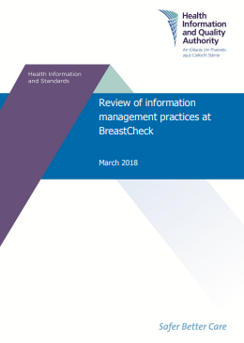
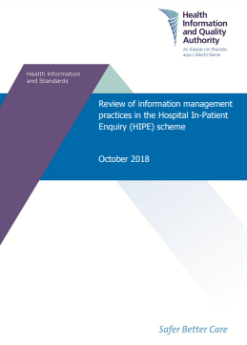
Health Information Review Programme
HIQA has developed a structured review programme to assess compliance with the Information management standards for national health and social care data collections.
A number of national data collections within the HSE have been reviewed to date, including 'BreastCheck‘ the Hospital In-Patient Enquiry (HIPE) scheme, and the National Incident Management System (NIMS).
To assist health and social care professionals improve their knowledge and skills in the area of information management, HIQA has developed an online learning course which includes the following modules:
Introduction to data quality
Developing a data quality framework
Notes:
HIQA undertakes a review programme to assess compliance with national standards for national data collections and eHealth services within HIQA’s remit (in the HSE and Tusla) in Ireland. The aim of this programme is to drive quality improvements by identifying areas of good practice and areas where improvements are necessary.
The review programme assesses key areas of information management such as Governance, Leadership and Management, Information Governance and Use of Information. HIQA has developed a Self Assessment Tool to enable national health and social care data collections to determine the extent to which they are compliant with the Information Management Standards. The tool helps to highlight areas where action is required or where improvements may be made.
HIQA develops guidance and resources to assist the health and social care sector to produce high-quality health information in order to support the delivery of safe care, decision-making, monitoring and planning for example Guidance on a data quality framework for health and social care.
HIQA has also developed an online learning course for all staff working in health and social care settings on the importance of high-quality data and information.

Slide 27
Section 4. Implementation Support Tools

Slide 28
Implementation Support Tools (guidance)
HIQA develops implementation support tools to assist services and staff to implement the national standards in their setting, or as a guide to making improvements in a particular area.
Throughout the standards development process, HIQA works to identify potential barriers and facilitators to the implementation of the standards and addresses these within the standards or through the development of additional support tools.
Examples of implementation support tools developed to date include:
- Online learning courses - Video animations
- Information leaflets - Academic slide decks
- Policy briefs - Easy-to-read guides
All resources are available on the HIQA website www.hiqa.ie. The online learning courses are available through HSeLanD, in the course catalogue ‘Health and Social Care Professionals’. The courses should be completed on HSeLanD if a certificate of completion is required.
Notes:
At all stages in the development of National Standards, HIQA seeks to identify and understand potential barriers and facilitators to the implementation of National Standards in health and social care services.
To do this, HIQA engages early and often with people with experience of using services, staff, service providers, policymakers, advocates and subject matter experts to ask them what they see as the barriers, for example knowledge gaps, and facilitators to the implementation of the standards, such as national policy or protocols, or centrally provided training for staff.
This is done by asking specific questions during the scoping consultation, at Advisory Group meetings, during focus groups, and as part of the public consultation on draft standards.
The following slides show support tools that were developed to assist services and staff to put the National Standards for Adult Safeguarding and the National Standards for Infection Prevention and Control in Community Services into practice.
A more detailed example is then presented setting out the tools that have been developed to support a human rights-based approach in health and social care services.

Slide 29
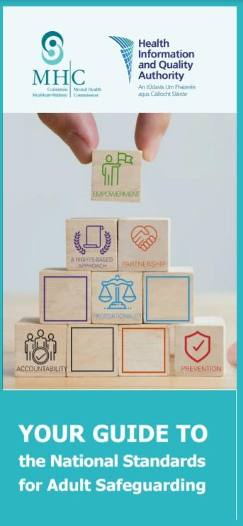
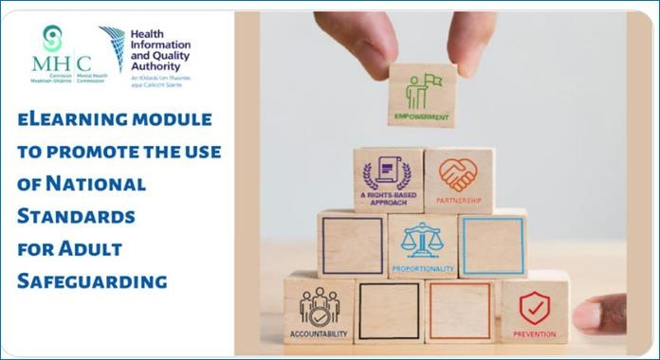
Implementation Support Tools
– National Standards for Adult Safeguarding
Video animation for National Standards for Adult Safeguarding
The online learning course is available on the HIQA website: National Standards for Adult Safeguarding: Putting the Standards into Practice.
The course is also available on HSELanD.
Leaflet for people using health and social care services setting out what these standards mean for them

Slide 30
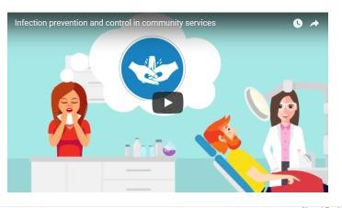
Implementation Support Tools –
National Standards for infection prevention and
control in community services
Online learning: The online learning course ‘National Standards for Infection prevention and control in community services: Putting the standards into practice’ can be accessed on
www.hseland.ie
Video animation outlining what infection prevention and control and antimicrobial stewardship are and what measures people and services can take to prevent the spread of infection.
Information leaflet for people using services on the National IPC Standards. This outlines key messages from the standards and what people using services can do to prevent the spread of infections.

Slide 31
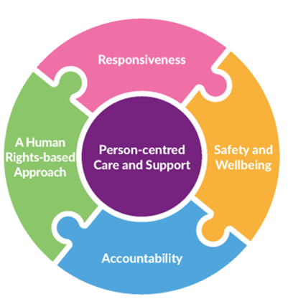
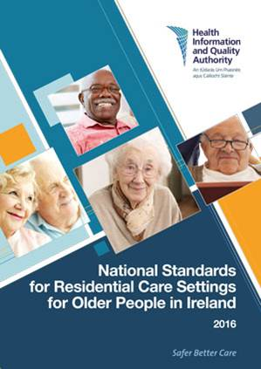
A Human Rights-based Approach in Health and Social Care Services
HIQA is committed to promoting best practice in human rights within health and social care services.
National standards, tools and inspection methodologies developed by HIQA are underpinned by the principles of equality and human rights.
Reference to human rights and a human rights-based approach to care and support is made in a number of the national standards and a human rights-based approach is one of the four key principles of the new Standards Development Framework.
Notes:
A number of the national standards developed by HIQA make high-level reference to human rights and a human rights-based approach to care and support, with emphasis placed on protecting and promoting people’s rights and respecting their autonomy, privacy, dignity, and their values, preferences and diversity. The standards describe high-level outcomes that services should aspire to.
Some of the national standards in which a human rights-based approach to care and support is referred to are:
National Standards for Safer Better Healthcare (2012)
National Standards for Residential Services for Children and Adults with Disabilities (2013)
National Standards for Residential Care Settings for Older People in Ireland (2016)
National Standards for Safer Better Maternity Services (2016)
National Standards for Adult Safeguarding (2019).

Slide 32
Human Rights-based Approach
A Human Rights-based Approach ensures that the human rights of people using health and social care services are protected and supported in practice and embedded in service culture.
Notes:
Human rights are enshrined in legislation nationally and internationally, and there has been a clear shift in recent years in healthcare policy and practice to a focus on human rights, empowerment and choice.
However, it was recognised that there was a lack of knowledge and understanding of the application of human rights principles among people using services, health and social care practitioners and at organisational levels.
This was recognised by, among others, the State’s regulators—HIQA and the Mental Health Commission—in their annual and overview reports on inspection and regulation of health and social care services.
HIQA aimed to address this by developing a guidance document and a suite of additional resources to support staff’s knowledge and understanding of what human rights are and how they are relevant to their work. The tools developed aim to assist practitioners in incorporating legislative requirements and principles into practice and to support them to implement national standards developed by HIQA.

Slide 33
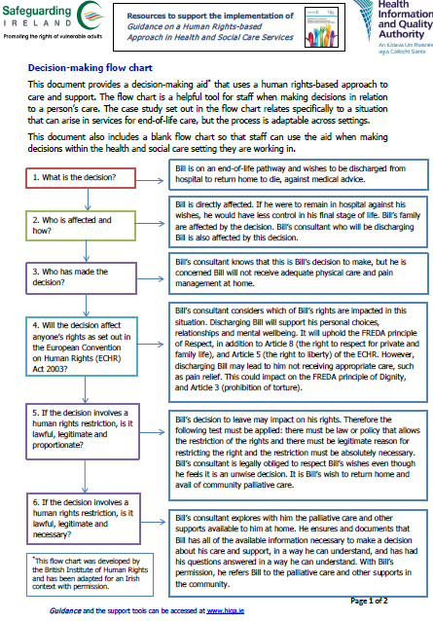
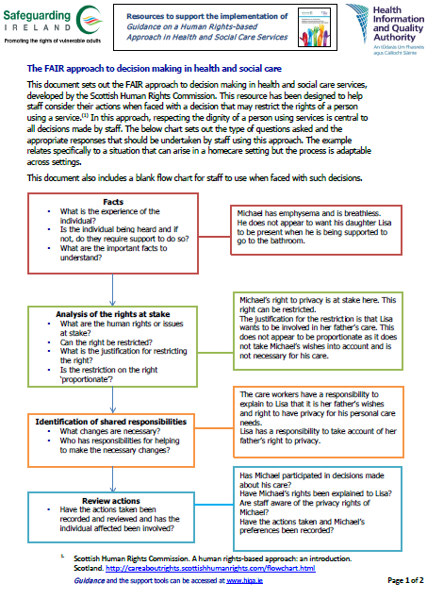
Tools to Support a Human Rights-based Approach in Health and Social Care Services
Guidance for staff
Decision-making flow charts
Decision making video by people using services
Academic Slide Deck
Legal Framework
FAQs
Notes:
Implementation support tools to support a human rights-based approach in health and social care services
Guidance on a Human Rights-based Approach in Health and Social Care Services
Academic Slide Deck on a human rights-based approach: for those teaching health and social care students and those providing training for health and social care staff.
Frequently asked questions (FAQ) about the Guidance on a Human Rights-based Approach in Health and Social Care Services and how it can help staff in their work
Legal framework document: outlining the key national and international legislation underpinning a human rights-based approach to care and support in Ireland
Document linking national standards to human rights: document linking national standards developed by HIQA to human rights as set out in the ECHR and UNCRPD
Decision-making aids: helpful tools for staff when making decisions in relation to a person’s care and support, particularly when faced with a decision that might restrict the rights of a person using a service.
Decision-making in Health and Social Care Services video: a video with members of Galway Advocacy Council, a self-advocacy group in the Brothers of Charity organisation, setting out what being at the centre of the decision-making process means to them.

Slide 34
Tools to Support a Human Rights-based
Approach in Health and Social Care Services
Online learning courses
Notes:
E-learning course for front-line staff: builds upon the Guidance on a Human Rights-based Approach in Health and Social Care Services which was published in November 2019. The course consists of four modules, including:
Module 1: Introduction to Human Rights in Health and Social Care
Module 2: Role of Good Communication in Upholding Human Rights
Module 3: Keeping People at the Centre of Decision-Making; and
Module 4: Positive Risk-taking
The course gives staff an opportunity to reflect and build on their good practice through engaging with practical scenarios describing real-life examples of good and poor practice, self-reflection questions and links to additional resources to extend their learning.
Each module takes 20-30 minutes to complete.

Slide 35
Tools to Support a Human Rights-based
Approach in Health and Social Care Services
Video animation on human rights in health and social care services
A short video animation was launched to raise awareness among people using services of what they should expect from a health or social care service that is committed to respecting, protecting and promoting their human rights. This video is available to view on the HIQA website.

Slide 36
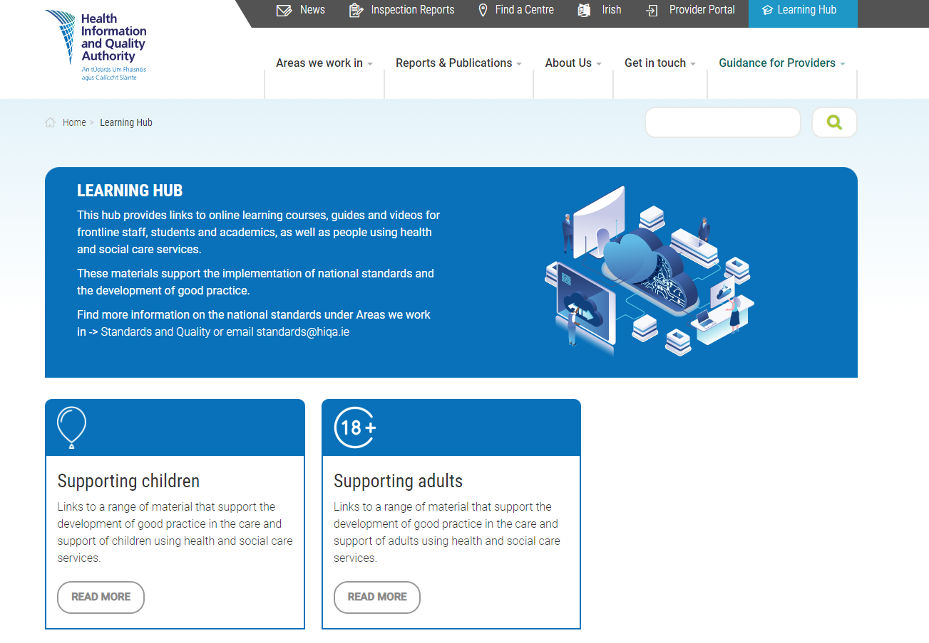
HIQA Learning Hub
HIQA Learning Hub.
Notes:
In May 2023, HIQA launched the new Learning Hub on the HIQA website.
The hub provides links to a range of resources and materials that support frontline staff to put national standards into practice.
The hub is designed to be a quick and easy way for frontline staff, as well as students, academics, and people using services, to access our range of online learning courses, guides and videos.
The hub is divided into two sections – links to resources and materials that support children and those that relate to supporting adults. The standards team will continue to add new materials to the hub as they are developed and published.

Slide 37
Section 5. Impact

Slide 38
Communicating the Work of HIQA & National Standards
It is important to ensure the national standards and implementation support tools developed reach target audiences, and that they have an impact on the quality and safety of health and social care services in Ireland.
HIQA increases awareness and understanding of its national standards, guidance, tools and resources through communication and dissemination.
Academic papers
Practice development guidance
Service Provider Roadshows
@hiqa
@hiqaireland
Online learning courses on HSeLanD
Highlighting HIQA’s work at conferences and on social media
Contribute to academic books
HIQA
@hiqaireland
Notes:
HIQA has developed a strategic direction to guide the development of national standards and implementation support tools and to ensure they have an impact on the quality and safety of health and social care services in Ireland.
The Health and Social Care Standards Strategy 2022-2024 includes an objective to Enhance dissemination of standards and implementation support tools, increasing reach, understanding and application of standards.
The team increase awareness and understanding of national standards, guidance, tools and resources developed by HIQA through communication and dissemination. This is achieved by:
highlighting the work of the standards team at conferences, through oral or poster presentations, facilitating workshops or providing information to attendees both in Ireland and across Europe
developing practice guidance to support health and social care workers to apply standards to their day to day work
contributing to articles, newsletters and academic books for various professional organisation and public bodies
providing updates of the work been carried out by the standards team on social media
collaborating with internal departments in HIQA, such as regulation, to provide service provider roadshows to inform those working in health and social care services about the standards, tools and recourses developed to support them in their work
publishing academic papers based on the research and work been carried out by the standards team
developing easy-to-read versions of documentation and national standards
launching online learning courses on HSeLanD for health and social care workers
developing a learning hub on the HIQA website for health and social care staff to access resources

Slide 39
Implementation of National Standards
A review of the literature was undertaken to identify and describe the most frequently reported enablers and barriers to implementing (inter)nationally endorsed health and social care standards.
The review examined 35 studies in 11 countries and included 32 healthcare standards, three social care standards and two mental healthcare standards.
22 enablers and 24 barriers to implementing health and social care standards were identified.
Study published in BMJ Quality and Safety:
Systematic review:
Factors that influence the implementation of (inter)nationally endorsed health and social care standards; a systematic review and meta-summary
Yvonne Kelly, Niamh O’Rourke, Rachel Flynn, Laura O’Connor, Josephine Hegarty.
Notes:
It is important to understand enablers and barriers to the implementation of national standards as this can aid decision-making when selecting support actions and implementation support tools.
You can read the published study in more detail at https://doi.org/10.1136/bmjqs-2022-015287 (Kelly Y, O’Rourke N, Flynn R, O'Connor L, Hegarty J. Factors that influence the implementation of (inter)nationally endorsed health and social care standards: a systematic review and meta-summary. BMJ Quality & Safety Published Online First: 08 June 2023).

Slide 40
Enablers and Barriers
Enablers to implementation of standards
Services use support tools at local level to prompt compliance, improve performances and assure effective implementation of standards.
Recruitment and availability of staff such as designated personnel who act as champions and role models are key elements to implementation of standards.
Services have training courses to increase awareness and knowledge of the standards and help implement the standards.
Barriers to implementation of standards
Services have a lack of knowledge, awareness and understanding of what standards are.
Services have insufficient time to implement standards due to increased service capacity and work overload.
Notes:
Some examples of the enablers and barriers that were reported in the literature are detailed below.
31 studies reported enablers to implementing health and social care standards. Of these 31 studies, 17 reported that using support tools at local level prompted compliance and improved performances. 16 studies reported that recruitment and availability of staff were key to implementing standards. Key staff members described in studies included champions, designated personnel, specialist nurses and physicians. 16 studies reported that training courses (education) increased awareness and knowledge of the standards. Training courses included targeted training, national training, in-service training, workshops and role play sessions.
35 studies reported barriers to implementing health and social care standards. Of these 35 studies, 22 reported a lack of knowledge, awareness and understanding of what the standards are. This gap in knowledge, awareness and understanding of standards related to the rationale for standards; content of standards; expectations of service delivery; available support tools. 15 studies reported that services were experiencing increased capacity and work overload that resulted in a lack of time to implement the standards.
An understanding of these enablers and barriers will assist in decision-making when selecting appropriate implementation support actions and support tools. These support actions and support tools aim to help health and social care services with the implementation of standards, ultimately for the benefit of service users. For example, selecting and then developing an e-learning module can help overcome barriers such as a lack of knowledge of what the standards are.

Slide 41
Engagement with Stakeholders
HIQA engages with staff working in, and people with experience of using health and social care services, to raise awareness of and to inform the development of its national standards, guidance, tools and resources.
Engagement with key stakeholders is important as it:
ensures that national standards, guidance, tools and resource developed by HIQA are relevant and fit for purpose.
provides an opportunity for those using and working in services to inform and shape the content of the national standards, guidance, tools or resources in development.

Slide 42
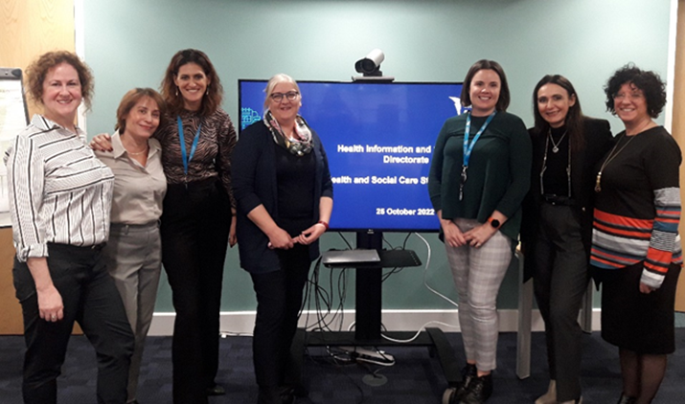
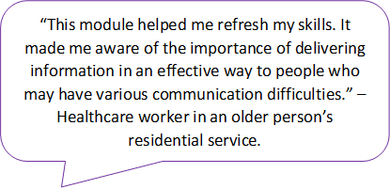
How HIQA Engages with Stakeholders
Engagement with key stakeholders includes:
formation of Advisory Groups and working groups
public consultations
focus groups with people working in and using health and social care services, professional organisations and public bodies
surveys
online learning course evaluation surveys
collaboration with an external organisations to share our learning and expertise
formation of a children’s reference group.
International collaboration
Online learning course evaluations
Focus groups
Notes:
Engagement with key stakeholders includes:
formation of Advisory Groups and working groups to support and assist in the development of national standards, guidance, tools and resources
public consultations, for example, to inform the development of a draft set of National Standards for Home Support Services.
focus groups with people working in and using health and social care services, professional organisations, and public bodies
surveys to gather feedback and insights into what is important to people working in and using health and social care services
online learning course evaluation surveys to gather feedback on the courses and to assess their impact on learners and how they intend to change or improve their practice
collaboration with an external organisations to share our learning and expertise
formation of a children's reference group to provide insight into the issues that are important to children and families using services while developing Overarching children’s standards.

Slide 43
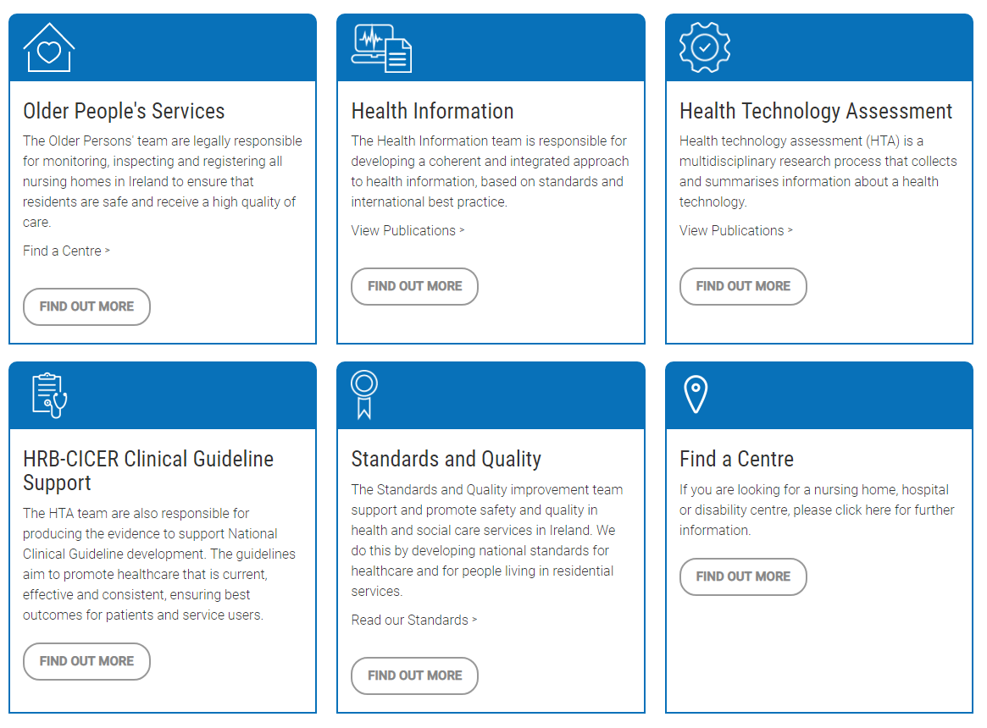
Where to Find Out More
You will find more information by visiting the Standards and Quality section on the HIQA website https://www.hiqa.ie.
All resources are also available to view and download from the HIQA Learning Hub.
HIQA Health Information and Standards Directorate
Health and Social Care Standards
standards@hiqa.ie

Slide 44
Follow us on:
Contact us:
Email: standards@hiqa.ie
Phone: 01 814 7400
Sign up to HIQA news: www.hiqa.ie
@hiqa
@hiqaireland
HIQA
@hiqaireland
If you found this slide deck useful, or have any comments or suggestions, we would love to hear from you!

